Slide 1
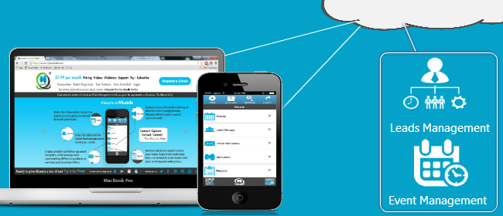
The Next Evolution in Event Management and Lead Automation
Using EASY technology to achieve better results

Slide 2
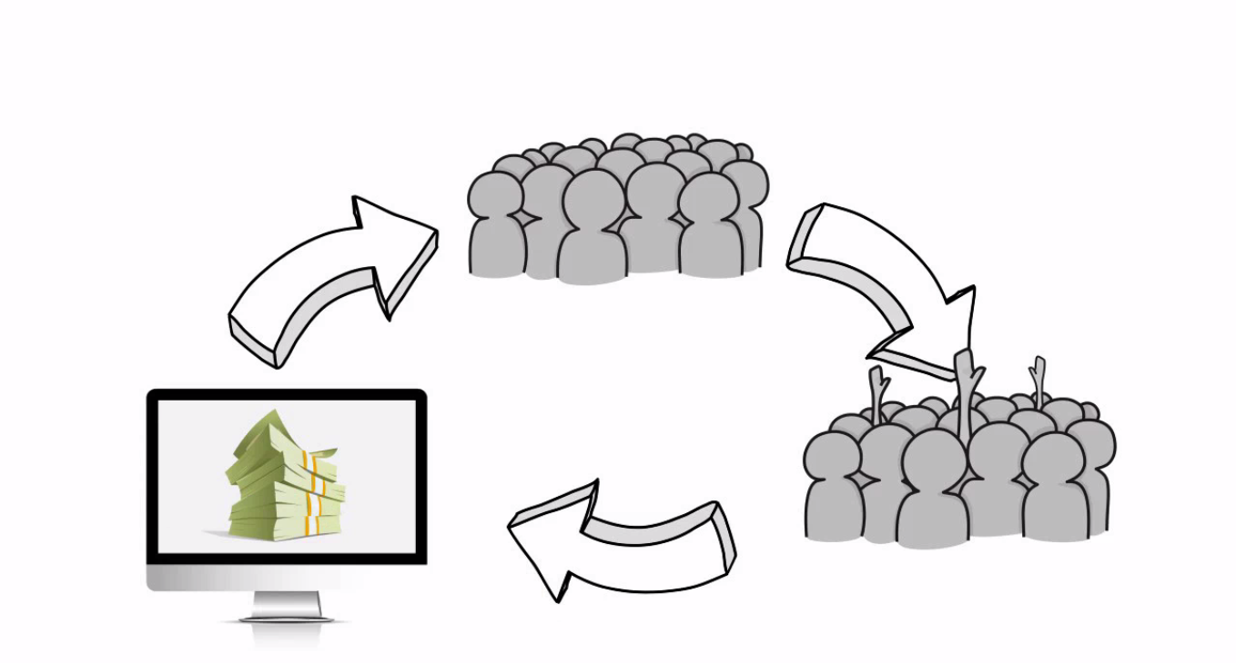
As you know, turning leads into sales is complicated

Slide 3
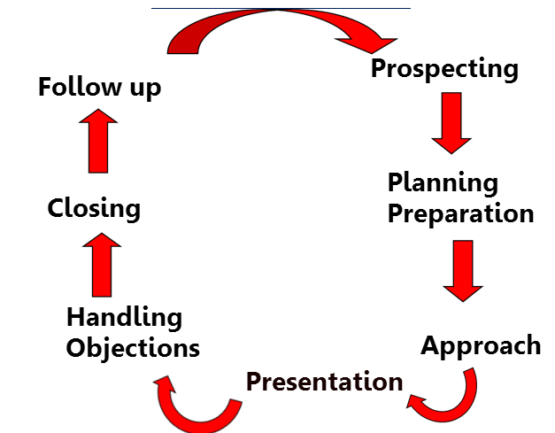
Leads are difficult to capture and organize, follow-ups are difficult and sales cycles are long

Slide 4
ROI is difficult to measure, events are difficult to manage, dependency on support staff is frustrating and so on...

Slide 5
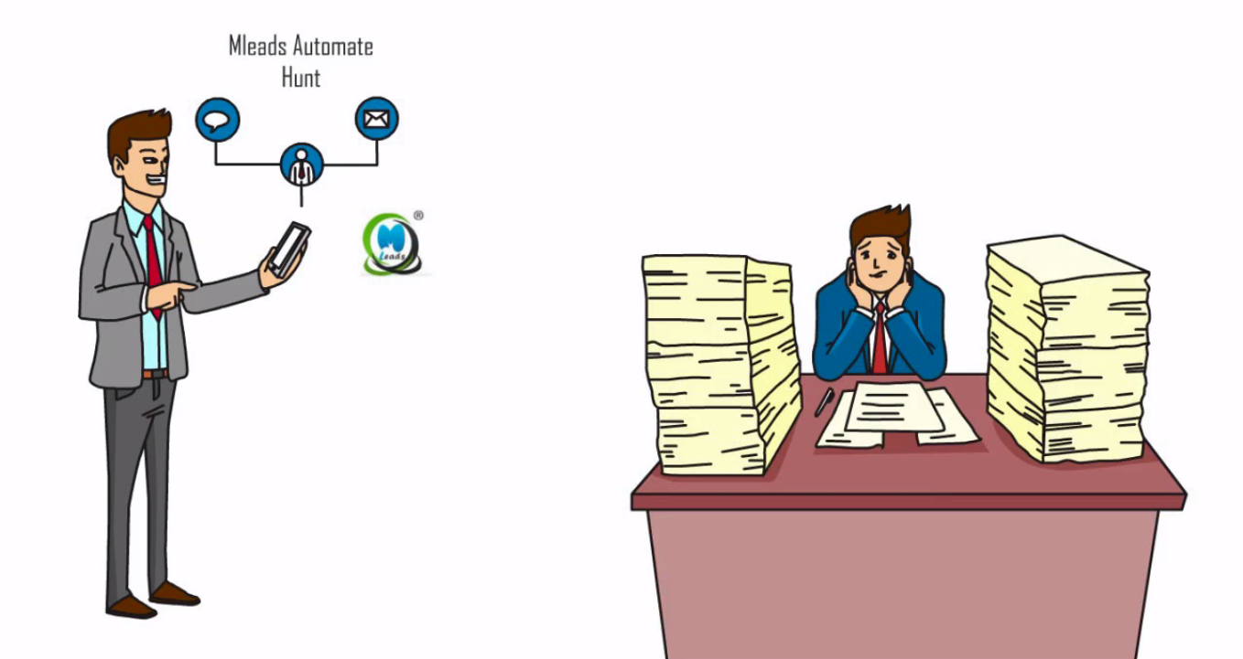
Introduce MLeads
MLeads is a cloud technology (SaaS) based one-stop innovative mobile platform for leads and events management automation. MLeads is built to solve these problems by offering intuitive design and a process that is easy to understand and follow for sales and marketing professionals and event organizers.

Slide 6
MLeads is the Next Evolution in lead and event management automation setting the business development and trade show industry standards on fire.

Slide 7
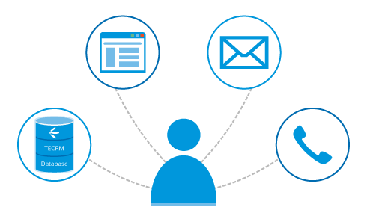
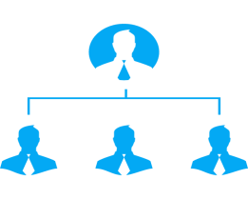
Following problem areas are being solved using MLeads
Lack of Productivity
Not having access to information instantly and anywhere without being dependent on support staff
Not having the ability to reach
out and follow-up leads
Not having clear visibility
across sales team efforts
Not having ability to share personal contact details video profiles capability
to show product and services demo anywhere
Not having easy to use process flow to manage presales activities

Slide 8
Why to choose MLeads ?
MLeads platform empowers small businesses to have the same tools that big businesses have at much lower cost.
We believe in building strong and committed business relationship even after product has been delivered.
We give emphasize on client satisfaction and we keep on introducing innovative features for our product to enrich product experience for the clients.
Our extensive testing and QA checks ensure that our application runs smoothly on different platforms.

Slide 9
Lead Management
Connects
Captures
Contacts
Converts
MLeads
with leads efficiently
upon introduction
Leads into closed sales with the help of built in pipeline and sales management tools
large numbers
of leads automatically
leads throughout
the sales process

Slide 10
Sales Pipeline Management Overview
Lead's background on
Facebook
Linked In
Google+
Business Website
Event
Meeting, Seminar
Trade show Etc.
ROI
Follow up
Prospects
Sales
Enquiry
Research
Schedule follow up
email, phone call, Text
Schedule meeting, task Etc.
Leads Filtering
Leads grouping
Analytics – 360 view of Leads
Count, sales agent, Leads by data source, product

Slide 11
MLeads Stream Lines Lead Management

Slide 12
Lead Management Feature
Personalized mass email follow ups using predefined email message templates
Unique and powerful lead retrieval methods
One click Lead Research
Import and export data any source system to any destination system
Share your products or services videos in seconds with your prospects
Measure statistical report

Slide 13
How is MLeads solving the problem
better than the competition ?
Economical low-cost but powerful feature rich platform compare to competition
simple but powerful presales and
event management automation system
Offers many innovative features
to quickly capture leads information
Quick follow-ups and
lead research capabilities
Simple easy to follow and
intuitive user interface
Ability to import/export data

Slide 14
Event management Feature
Setup online event registration, invite prospective attendees, upload sponsors and event agenda
Custom registration fields and email templates for reminders
Manage sessions and speakers information, manage social media for the event
Design and create badges
with QR codes
Keep track of registered
attendees and event revenue collection
BeSocial™proprietary feature which helps attendees in interacting with other attendees in real-time
Manage services for exhibitors

Slide 15
Steps for event Setup
Set up & Modify Registration
Click the event you like to attend and hit the registration
Manage Tickets
Ticket generation through free, paid, donation , discount code
Manage Service
Service usability via free and paid mode for value added services
Never Lose a Lead Again..
Manage session
Customized session management with free and paid payment mode
Advance option
Customize email template, manage promo code, be –social feature, customized Badge categories ,import prospective attendees
Event Help
Manage Walk-in Registration, Print Badge, view & export registered attendees and review collection
Successful Event

Slide 16
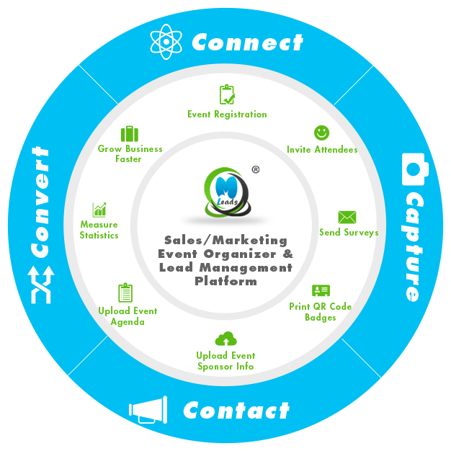
Event Management Cycle

Slide 17
The Team
We believe in collaboration. We are committed toward creating healthy work relationship at workplace. Our team strives to work hard for enriching users experience and maintaining long term relationship.
Management team
Software Development team
Recruitment team
Marketing team
Tech Support team

Slide 18
The Right process
Success
The Right Tool
Summary
MLeads is One stop solution for
Lead management
and Event Management

Slide 19
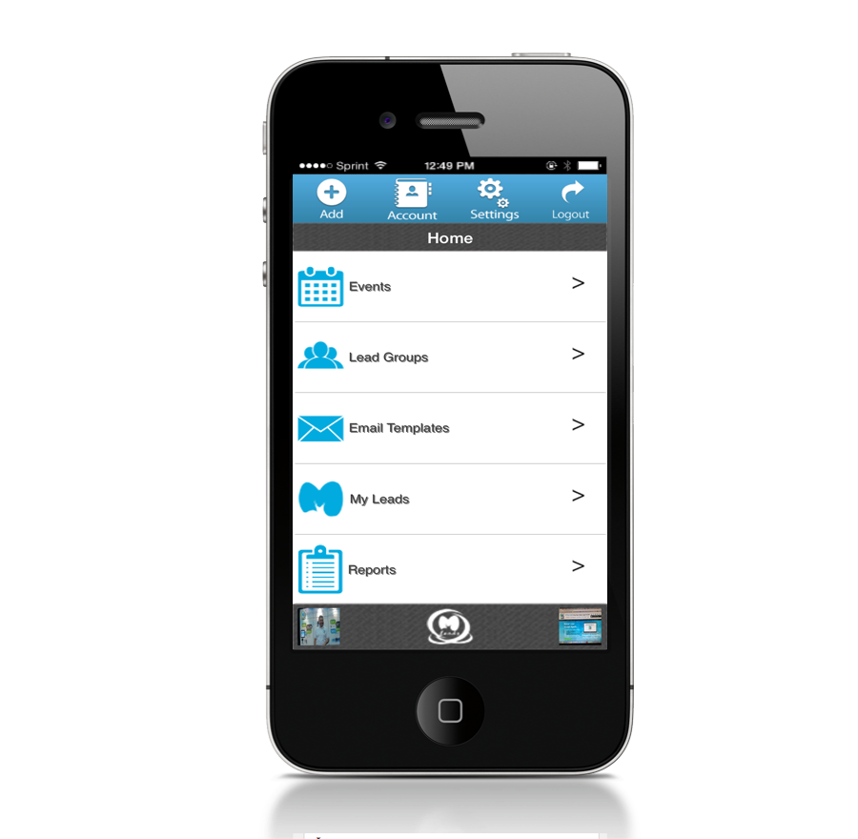
Special Thanks from MLeads
Mobile Leads LLC
Business Center, of Lansdale
650 North Cannon Avenue, Lansdale, PA 19446
Phone:(267)263-3178
Fax: (267)-200-0026
For more in-depth features information,
Visit: www.myleadssite.com
Email : info@myleadssite.com
We offer 15 days free trial

